Slide 1
KASKAID
Casework database

Slide 2
KASKAID was set up and designed by legal aid caseworkers who found the “one-size fits all” off-the-shelf databases/case management systems non-user friendly and designed without taking into consideration the way in which an actual caseworker/lawyer would expect to use work.
Added to this was the continuing costs (monthly rental per user) without the flexibility to adjust the system to the way in which the individual company actually worked.
The following are screen shots from the trial version to give you an idea of what is available. We don’t believe that one-size fits all! So, if you require any additions/amendments to the system, this is possible thereby making the system bespoke to your company!
If after looking at the screen shots you would be interested in having a hands-on test of our trial version, details of how to obtain this are on the last screen.

Slide 3
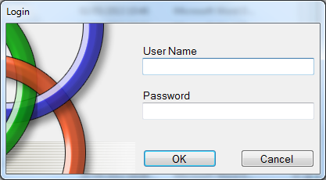
Login Screen
Kaskaid is very simple to use. There is one programme, with individual login’s for each user. This is the login screen where the user enters their user name and password as assigned by the System Administrator.

Slide 4
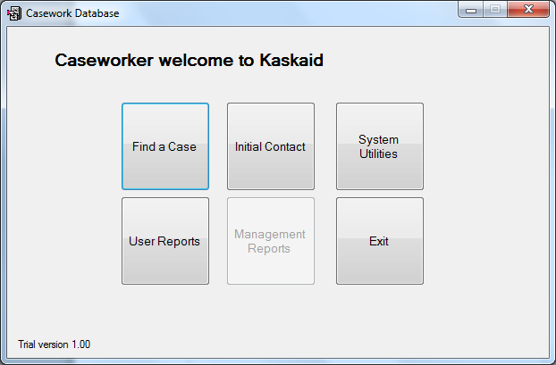
This screen allows the user to access various sections of the database.:
“Find a Case” will take the user to a search screen where open cases can be searched;
“Initial Contact” will take the user through the set up of a new client/case.
“System Utilities” will take the user through to the background data for the database.
“User Reports” will take the user through to the reports available for a user to monitor their own performance.
“Management Reports” greyed out here, is only available to those with specific permission.
“Exit” exits the database

Slide 5
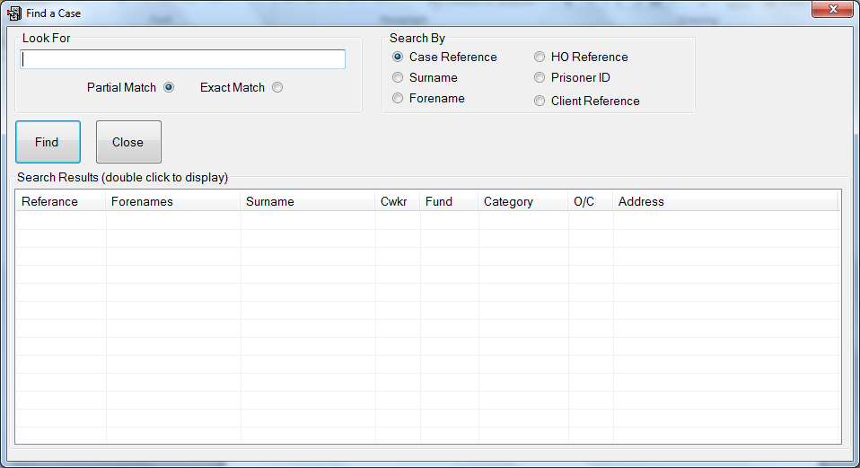
Find a Case
This screen allows the user to search all entries on the database by various categories. These categories can be amended/added to, to suit the needs of the company.

Slide 6
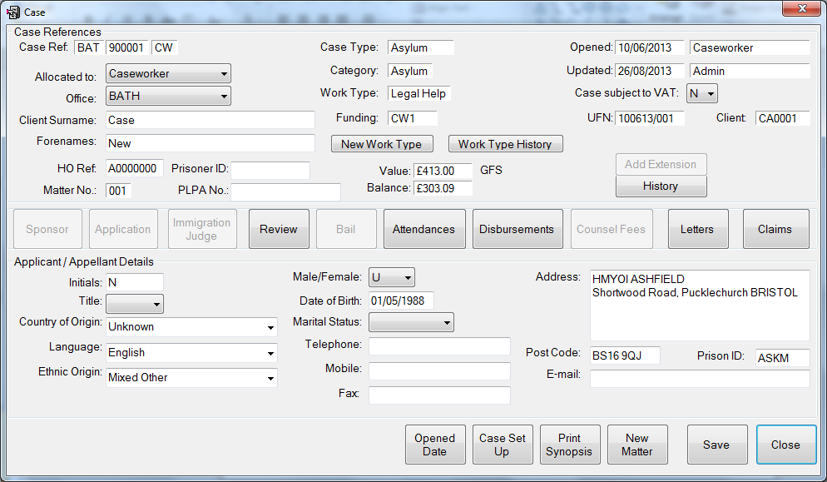
Case Data Screen
This is the main case details screen where all the standard statistical and reporting information is recorded. The data fields can be amended/added to should a company wish it.

Slide 7
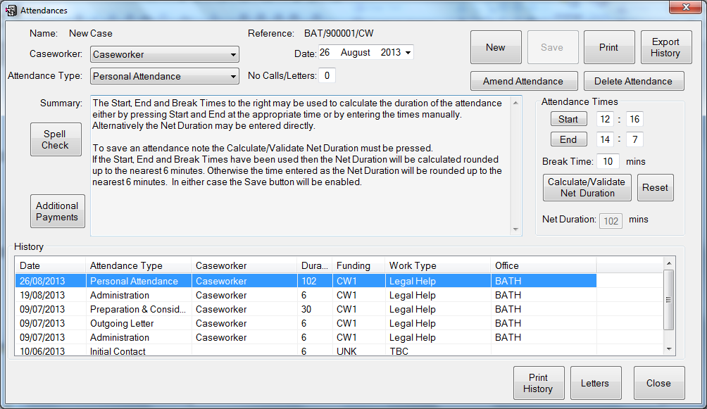
Attendance Notes Screen
This is where all the attendance or file notes are recorded. It is possible to record attendance notes for different caseworkers on the same case. Attendance notes can be amended or deleted. A report of all the attendance s on the case can be run which assists when reporting to the LAA.

Slide 8
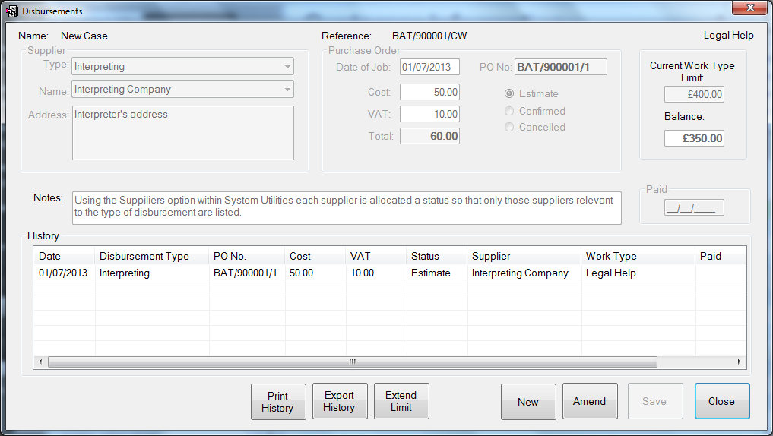
Disbursements
This screen is where all disbursements are recorded. A list of suppliers can be uploaded from an excel spread sheet when setting up the system, and added to as and when required through a facility in “System Utilities”. The different types of disbursement can be added to/amended as required.
Purchase Order numbers can be generated through this system to assist with tracking of invoices.

Slide 9
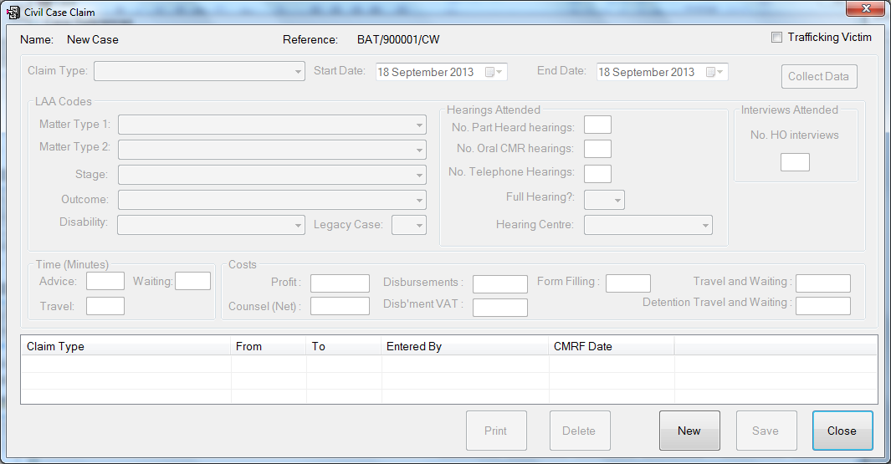
Claiming a case
This screen is where the LAA required claiming is completed. The user can make the necessary claim at each stage of the case with limited input required. The claims are then gathered into a central report for uploading to LAA Online.
This screen can be adapted to report any type of case, for any purpose.

Slide 10
Other elements available
Letters – standard letters can be added and set to merge with any data recorded on a case entry.
Cost limit extensions
Recording of counsel fees
COLP/COFA reporting
Bespoke reports
LAA reports
Amendments/ additions can be made as required to assist users and companies with their specific/individual needs.

Slide 11
If you would like to test a trial version of the database, please contact:
contact@kesarco.co.uk
We will send a trial version to download so you can test the system and see whether it meets your requirements.

